Slide 1
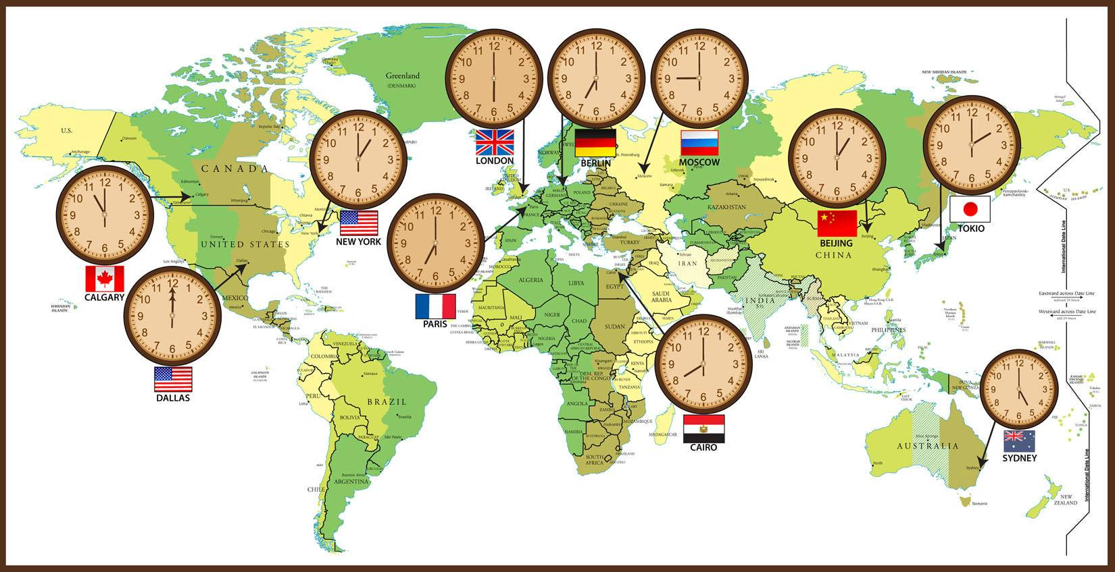
CLIL-GEOGRAPHY: TIME ZONES

Slide 2


Slide 3
* Match the words with their suitable definitions:
WORDS | DEFFINITIONS
1/ longitude | a/ is the direction that you look towards to see the sun rise.
2/ Prime Meridian | b/ is the distance of a place east or west of the Greenwich meridian, measured in degrees.
3/ Greenwich Mean Time | c/ is the direction that is on your left when you watch the sun rise.
4/ East | d/ is the mean solar time at the Royal Observatory in Greenwich, London, counted from midnight.
5/ West | e/ is the meridian in a geographic coordinate system at which longitude is defined to be 0°.
6/ North | f/ is the direction that you look towards to see the sun go down.
7/ South | g/ is the direction that is on your right when you watch the sun rise.

Slide 4
WORDS | DEFFINITIONS
1/ longitude | a/ is the direction that you look towards to see the sun rise.
2/ Prime Meridian | b/ is the distance of a place east or west of the Greenwich meridian, measured in degrees.
3/ Greenwich Mean Time | c/ is the direction that is on your left when you watch the sun rise.
4/ East | d/ is the mean solar time at the Royal Observatory in Greenwich, London, counted from midnight.
5/ West | e/ is the meridian in a geographic coordinate system at which longitude is defined to be 0°.
6/ North | f/ is the direction that you look towards to see the sun go down.
7/ South | g/ is the direction that is on your right when you watch the sun rise.
1-b, 2-e, 3-d, 4-a, 5-f, 6-c, 7-g

Slide 5
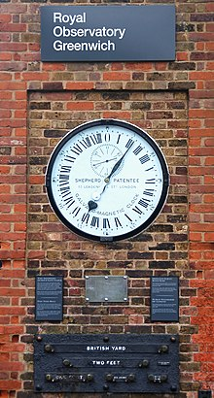
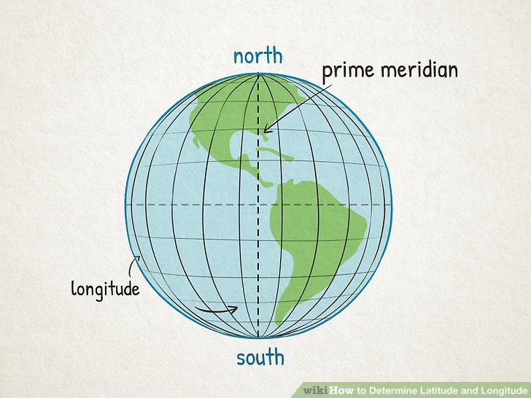
* NEW WORDS:
(n)
(n)
West (n)
East (n)
(n)
Greenwich Mean Time (GMT)
(n)

Slide 6
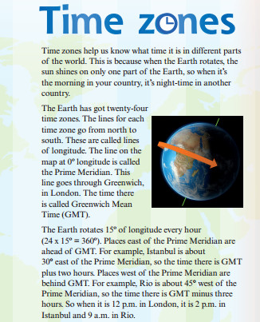
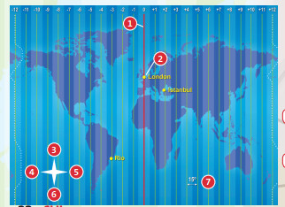

32

Slide 7
2/ Read and listen to the text and write “True” or “False”. Correct the false sentences:
1. Lines of longitude go from east to west.
False
2. The Prime Meridian is the name of a time zone.
False
3. Greenwich is a part of London.
True
4. The time in places west of the Prime Meridian is ahead of GMT.
False

Slide 8
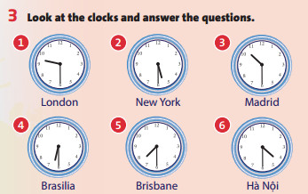
1/ In which countries are
cities 1-6?
2/ Is New York ahead of or
behind GMT?
3/ How many hours ahead
of GMT in Hà Nội?
4/ How many hours
behind GMT is Brasilia?
5/ If it’s 12p.m. in London,
what time is it in Brisbane?
6/ You are in New York at
9p.m. Is it a good idea to call
your friend in London?
Why/ Why not?

Slide 9
1/ In which countries are cities 1-6?
England, the USA, Spain, Brazil, Australia, Vietnam.

Slide 10
2/ Is New York ahead of or behind GMT?
It’s behind.

Slide 11
3/ How many hours ahead of GMT in Hà Nội?
It’s seven hours ahead.

Slide 12
4/ How many hours behind GMT is Brasilia?
It’s three hours behind.

Slide 13
5/ If it’s 12p.m. in London, what time is it in Brisbane?
It’s 10p.m.

Slide 14
6/ You are in New York at 9p.m. Is it a good idea to call your friend in London? Why/ Why not?
No, because it’s 2 a.m.

Slide 15
4/ Work in pairs. Complete the table. Then ask and answer questions about the time in the different cities:
CITY | GMT +/- | TIME
London | - | 1p.m.
Tokyo | +9 hours
Mexico City |  | 8a.m.
Sydney |  | 11p.m.
Rio | -3 hours
Hà Nội | +7 hours
10p.m.
-5
+10
10a.m.
8p.m.

Slide 16
* Work in groups to find the time in different cities:
CITY | GMT +/- | TIME
London | - | 1a.m.
Phnom Penh | +7 hours
New Delhi | +5:30hours
Bangkok |  | 8a.m.
Lima | -5 hours
Caracas | -4:30 hours
8a.m.
6:30a.m.
+7 hours
8p.m.
8:30p.m.

Slide 17

* Homework: - Learn by heart all the new words. - Prepare for the next lesson – Unit 2: Puzzles and games.

